Slide 1

Capstone Project
By
Sharang
Savio
Rahul
Raybhan

Slide 2
Datasets:
Customer Data
Invoice
Inventory/JTD
Plant
Row – 555338
Column – 9
Row – 492314
Column – 58
Row – 5619484
Column – 9
Row – 438
Column – 13
17/58 Columns having 90% + null values
30/58 Columns having 40% + null values
25/58 Columns having single/null values
1/9 Columns having 67% null values
8/9 Columns having >1% null values
4/9 Columns having 90% + null values
1/13 Columns having 90% + null values

Slide 3
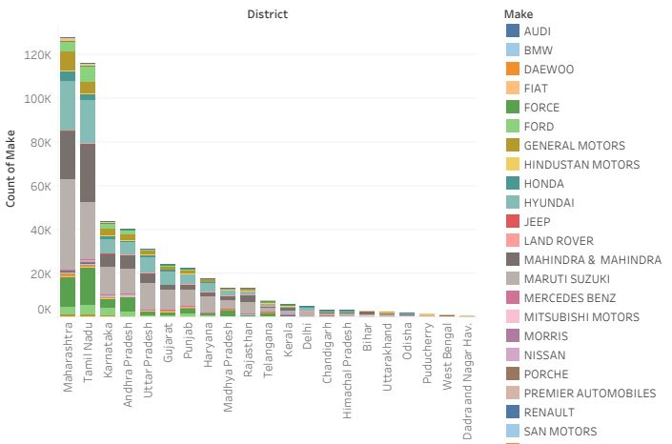
Problem Statement 1 : Identifying the ownership pattern
Graph depicts that 90% cars belongs to 10 states.
Most of the customers have economical class cars

Slide 4
Problem Statement 2 : Identifying Order Type Pattern
The company is in expansion mode, and that is evident from the year on year graph with an increasing number of presence in different states.
The year on year growth is driven by majorly three services: Accidental, Paid service, Running Repairs
By looking at the data for these services and their seasonal pattern with parts that are used frequently, we can come up with a new product that includes :
Accidental:
1.Painting charges
2.oil filter
3.URANIA SUPREMO CI 4 15W 40
4.Clutch Overhaul
5.SYNTIUM 3000 SM 5W 40
6.LABOR CHARGES
7.Repairing charge
8.MISC_OTHER CHARGES
Paid Service:
1.Paid Service-Major
2.oil filter
3.URANIA SUPREMO CI 4 15W 40
4.Clutch Overhaul
5.SYNTIUM 3000 SM 5W 40
6.LABOR CHARGES
7.Repairing charge
8.MISC_OTHER CHARGES
Running Repairs:
1.MISC LABOR 2 HOURS
2.oil filter
3.URANIA SUPREMO CI 4 15W 40
4.Clutch Overhaul
5.SYNTIUM 3000 SM 5W 40
6.LABOR CHARGES
7.Repairing charge
8.MISC_OTHER CHARGES
9.Paid Service-Minor

Slide 5
Is it seasonal :

Slide 6
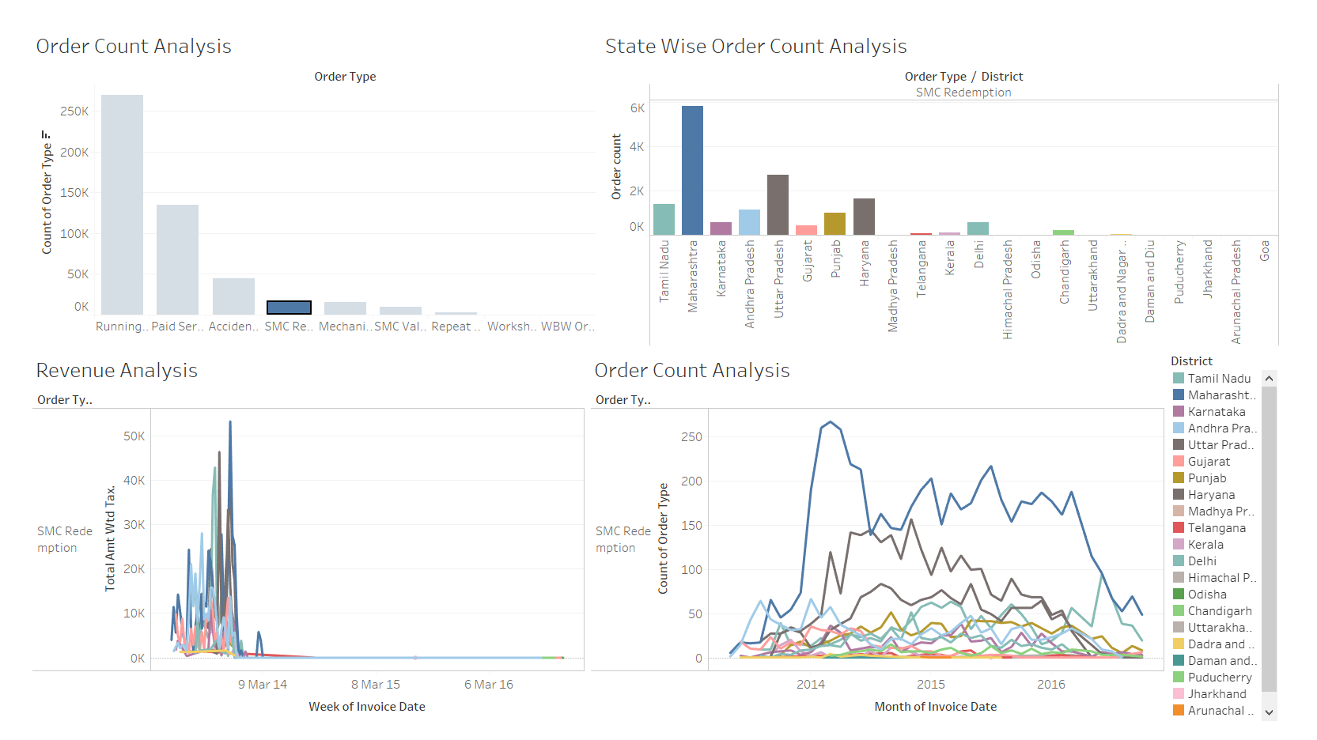
The SMC Redemption order type hasn’t been generating any revenue since April 2014, whereas vehicles have been serviced for the order

Slide 7
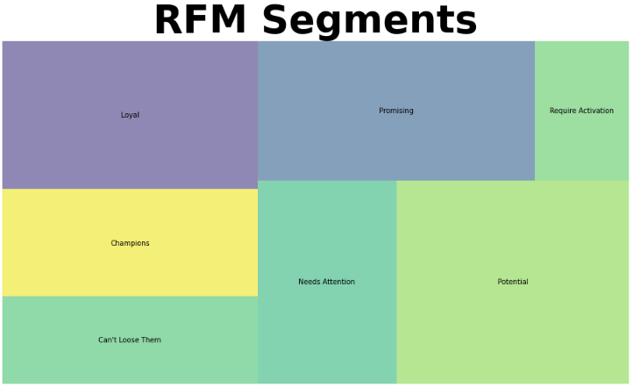
Market Segmentation:
(Market segmentation is based on RFM method )

Slide 8
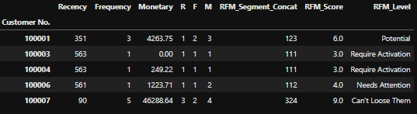
Market Segmentation :

Slide 9
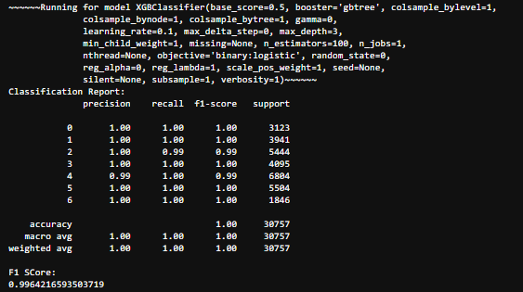
Market Segmentation: Verification

Slide 10
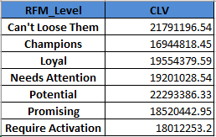
Customer Life Value based on Segments:

Slide 11
References:
https://towardsdatascience.com/tagged/data-driven-growth
https://towardsdatascience.com/data-driven-growth-with-python-part-3-customer-lifetime-value-prediction-6017802f2e0f
https://towardsdatascience.com/data-driven-growth-with-python-part-2-customer-segmentation-5c019d150444
https://towardsdatascience.com/predicting-the-future-with-facebook-s-prophet-bdfe11af10ff

Slide 12
THANK YOU

